Slide 1
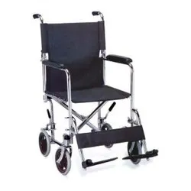
Smart Wheelchair
A GESTURE CONTROLLED WHEELCHAIR

Slide 2


THIS PROJECT IS FOR THE PATIENTS WHO ARE IN ICU’S AND NEED TO TAKEN FOR FREQUENT SCANNINGS AND TESTS, WE KNOW THAT THE PATIENTS IN ICU’S ARE NEED TO KEPT FAR FROM INFECTIONS BUT MANY PATIENTS ARE GETTING EFFECTED , THIS IS DUE TO POOR HYGIENE, IT IS ALSO HARD FOR THE NURSES OR DOCTORS TO MAINTAIN ABSOLUTE HYGIENE ALL THE TIME, IN SUCH CASES WE CAN USE THIS GESTURE CONTROLLED WHEELCHAIR , WHERE WE TRANSPORT THE PATIENT TO THE REQUIRED AREA
about us

Slide 3

Healthcare service
This project serves many patients in the hospitals, the patients will be contact less with maximum no of people while using this project
Mentally retarded patients
services
We know mentally retarded people cannot handle their wheelchair in their condition, hence this project will be helpful in transporting them.
General services
This project helps many physically handicapped people, using this project they can travel on their own,
Using this project principle we can use it for the baby cart, parents can move their child in the baby cart without any contact

Slide 4
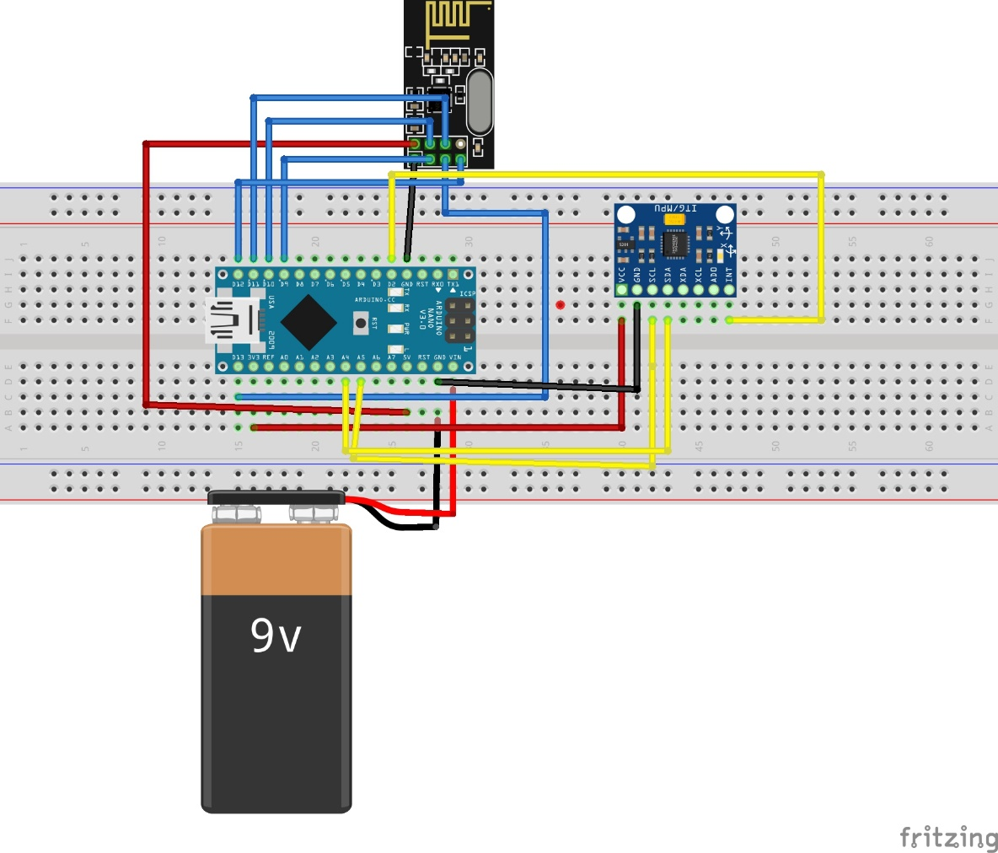
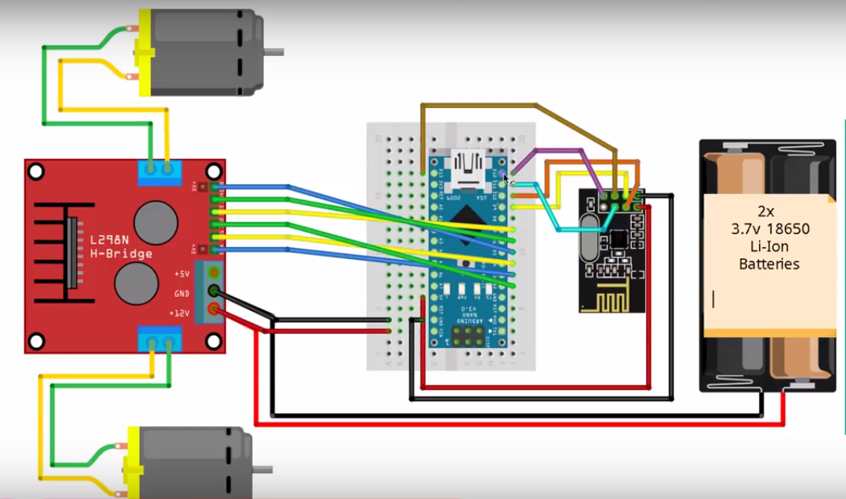
Transmitter
The transmitter consists the gyroscope, changing the coordinates of the gyroscope give the input to the receiver to move in the required direction, the transmitter is operated on Arduino nano v3, and we used nRF24l01 signal transmitter to transmit the output signal
portfolio
Receiver
The receiver is the second phase of the project, the receiver receives the input signal from the transmitter through nRF24l01 signal receiver, the Arduino nano is programed to operate in required direction while moving the gyroscope, the Arduino nano gives input to the motor driver the motor driver adjusts the speed of the motors

Slide 5
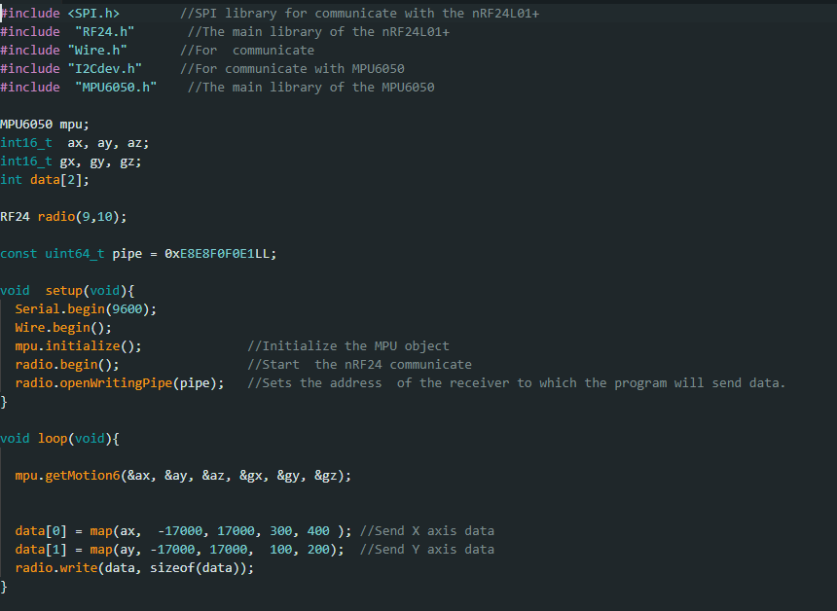
Transmitter code
portfolio

Slide 6
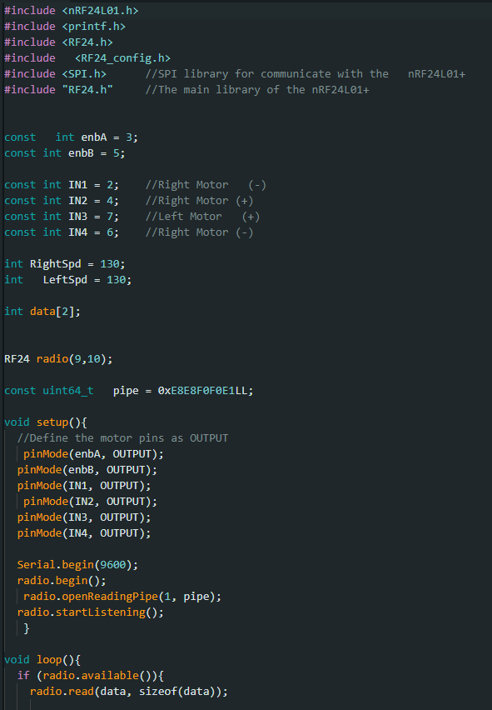
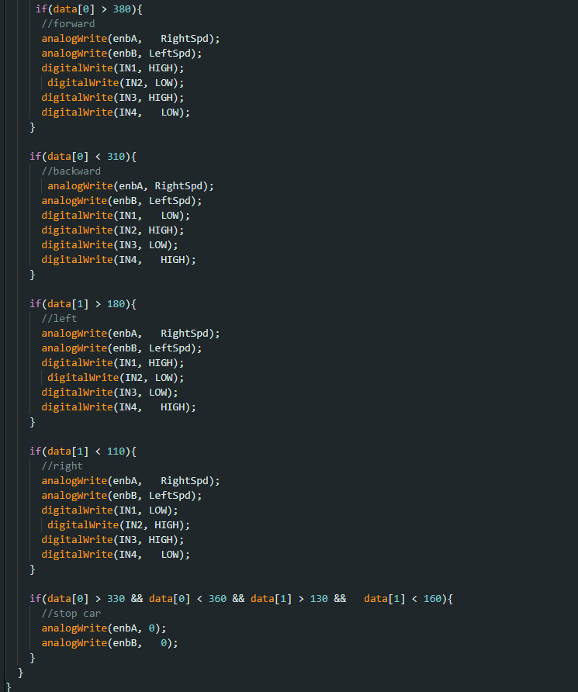
Receiver code
portfolio

Slide 7

This is an useful project for transporting the patients, using this project principle we can build many projects in many domains. The basic principle of this project is we use a gyroscope is placed on our hand, by moving the Arduino nano sends the info to the nrf24 signal transmitter, the another signal transmitter on the receiver side will receive the input signal and passes the info to the Arduino nano in the receiver, the Arduino nano is connected to a motor driver the motor driver adjusts the speed of the motors and moves the wheelchair
Summary

